Slide 1
FaultDetective Explainable to a Fault, from the Design Layout to the Software
CHES 2024
Zhenyuan (Charlotte) Liu, Dillibabu Shanmugam and Patrick Schaumont
WPI Vernam Lab
September 2024

Slide 2
Outline
What is Fault Root-Causing?
Current Fault Research
Dynamic State Transition Graph
Visualized Fault Patterns
Fault Root-Cause Analysis: FaultDetective
Fault Root-Cause Demonstration
Conclusion

Slide 3


What is Fault Root-Causing?
Explain Low-level Hardware Effects from High-level Software Observations
Why do we care?
High-Level
Software
Fault Effects
Faulty output
No effects
Halted CPU
We aim to understand more than just the immediate output effects!
Initial fault
Fault propagation
Impacts
Improved design
Cost Savings
Low-Level
Hardware
Fault Injection
2

Slide 4

Current Fault Research
Simulation-based research:
Based on a fault model of the design under test
Includes bit flipping, permanent faults, gate modifications, instruction skips, etc
Assumes specific locations of faults
Can explain low-level details but depends on the accuracy of the fault model, which may be incorrect
Empirical research:
Observes the real-world effects of faults
Limited visibility into low-level hardware details
Cannot explain the effects of faults at a high-level in software
Bridge this gap
Locate fault root-cause
Track fault propagation
Visualize fault behavior
FaultDetective
3

Slide 5
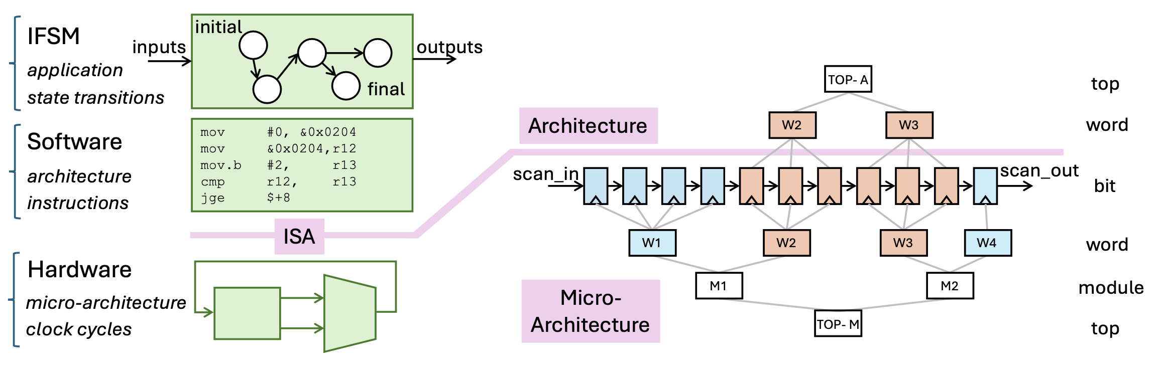
Architecture and Micro-Architecture States
High-Level FSM
Architecture State
TOP-A
Top
Architecture
Software
Programmer Visible Bits
W1
W2
Word
Bit
scan_in
scan_out
ISA
Hardware
W1
W2
W3
W4
Word
Micro-Architecture
M1
M2
Module
Programmer Visible Bits
Programmer Non-Visible Bits
TOP-M
Top
4
Micro-Architecture State

Slide 6
Hierarchical Hash Tree
Architecture State
Architecture State Digest
TOP-A
Root node
Hierarchical tree structure (leaf/root)
Any changes at a leaf node will result in a change at the root node
Backtrack from the root node to identify which leaf or intermediate node is faulty
Hash tree [1]
Top
Architecture
W1
W2
Intermediate nodes
Word
Leaf nodes
Bit
scan_in
scan_out
ISA
Intermediate nodes
Any changes from leaf/intermediate nodes will cause a different hash value in the root digest
Find the root-cause of the fault
W1
W2
W3
W4
Word
Intermediate nodes
Micro-Architecture
M1
M2
Module
Top
TOP-M
Root node
Micro-Architecture State
5
Micro-Architecture State Digest
[1] please refer to our paper to find more details on the hash function.

Slide 7
Dynamic State Transition Graph
Track the system behavior in graphs!
Architecture State Digest
Architecture Dynamic State Transition Graph (ADSTG)
TOP-A
Top
Architecture
Programmer Visible Bits
W1
W2
Word
A1
Per Instruction
A2
Bit
scan_in
scan_out
ISA
M1
W1
W2
W3
W4
Word
Per Cycle
M2
Micro-Architecture
M1
M2
Module
Micro-Architecture Dynamic State Transition Graph (MDSTG)
Programmer Non-Visible Bits
TOP-M
Top
6
Micro-Architecture State Digest

Slide 8
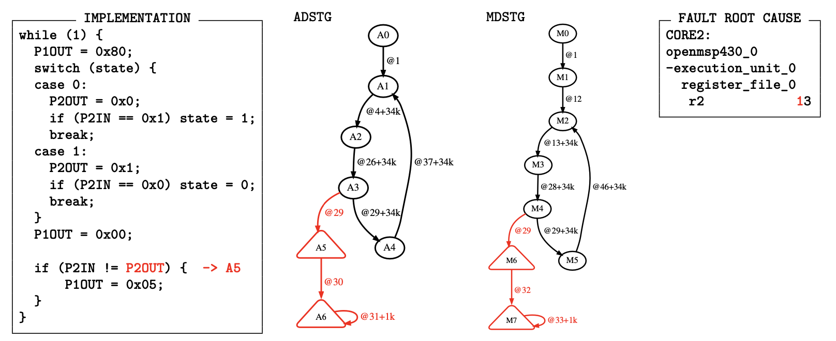
Dynamic State Transition Graph – Before Fault
Architecture state
Micro-architecture state
Programmer visible bits
Transition time
All bits
Pre instruction transition
Pre cycle transition
Sane State $→$ Achieved in accordance with the programmer’s intent^{[1]}
The Sane Machine $→$ The collection of all possible sane states
7
[1] Thomas Dullien. Weird machines, exploitability, and provable unexploitability. IEEE Transactions on Emerging Topics in Computing, 8(2):391–403, 2020.

Slide 9
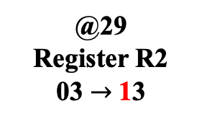
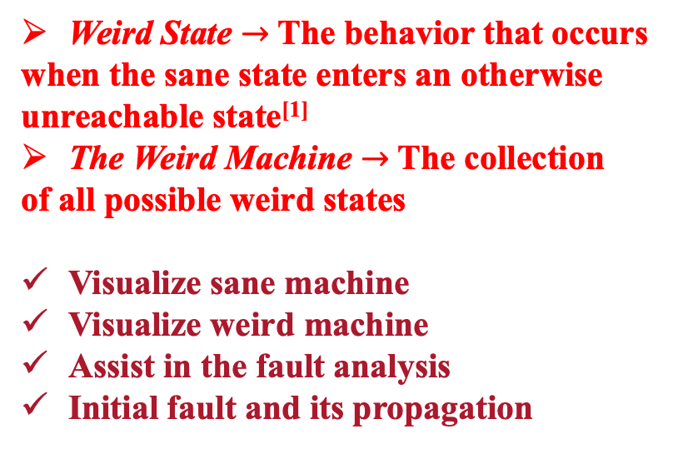
Dynamic State Transition Graph – After Fault
Architecture sane state
Micro-architecture sane state
@29
Register R2 03 $→$13
Architecture state
Micro-architecture state
Transition time
Disables further instruction-fetch
Halt the processor
Weird State $→$ The behavior that occurs
when the sane state enters an otherwise
unreachable state^{[1]}
The Weird Machine $→$ The collection
of all possible weird states
Visualize sane machine
Visualize weird machine
Assist in the fault analysis
Initial fault and its propagation
Architecture weird state
Micro-architecture weird state
8
[1] Thomas Dullien. Weird machines, exploitability, and provable unexploitability. IEEE Transactions on Emerging Topics in Computing, 8(2):391–403, 2020.

Slide 10
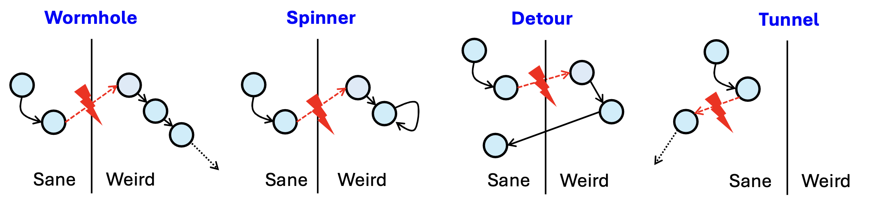

Visualized Fault Patterns
Four fault patterns
States
Weird machine does exist!
9

Slide 11
Fault Root-Cause Analysis: FaultDetective
Hardware Redundancy + Scan Chain
Core
Core
Lock-step execution
Minimal hardware in
on-chip network
Fault checking in software
by redundancy
Once a fault is detected,
halt all cores
Scan chain provides visibility
into all flip-flop bits
Processor
Peripherals
Memory
Registers
Core
On-chip Network
Core
Scan In
Core
Core
Scan Out
10

Slide 12
Fault Root-Cause Analysis: FaultDetective
Fault Detection by Software Redundancy
Fault Injection
Time
Software
Assembly
Initial fault (root-cause)
Detect differences among cores
Earliest fault detection
Document all register bits
periodically
Fault propagation
Hardware
Verilog
Fault root-cause
Scan
States
Scan states over time after fault
Plot the ADSTG/MDSTG for both sane and weird machine
Apply to both simulation and measurement fault experiments
11

Slide 13
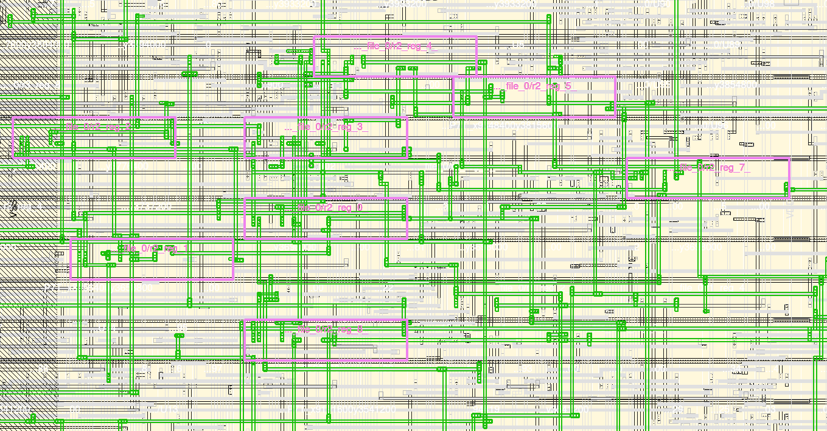

Layout-Aware Fault Analysis in Simulation
Realization in ASIC (six-core MSP430)
Implement real-world fault injection using layout data (laser and clock fault injections)
No assumptions about the fault
Layout Distribution
Selected Region
CORE2
CORE3
Layout P&R
Y-coordinate (𝝁𝒎)
CORE1
CORE4
Register Bit
CORE0
CORE5
RAM
Scan In
Scan Out
X-coordinate (𝝁𝒎)
12
Laser Spot Size = 15 $μm$

Slide 14
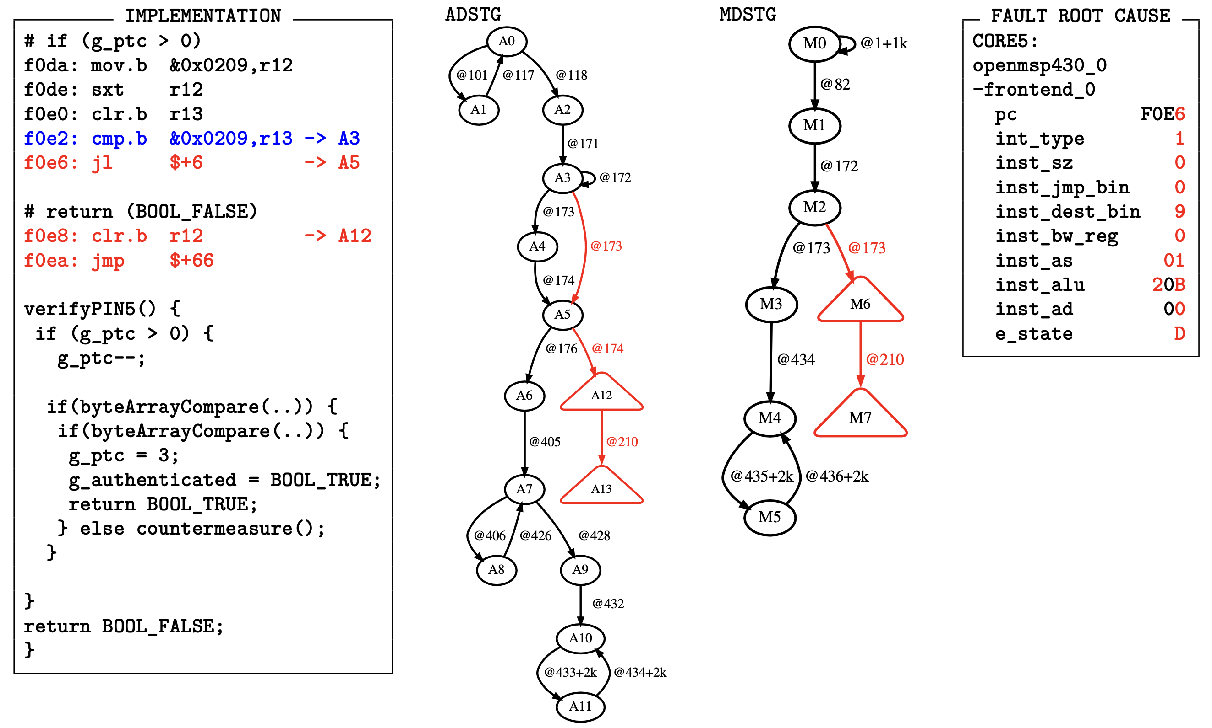
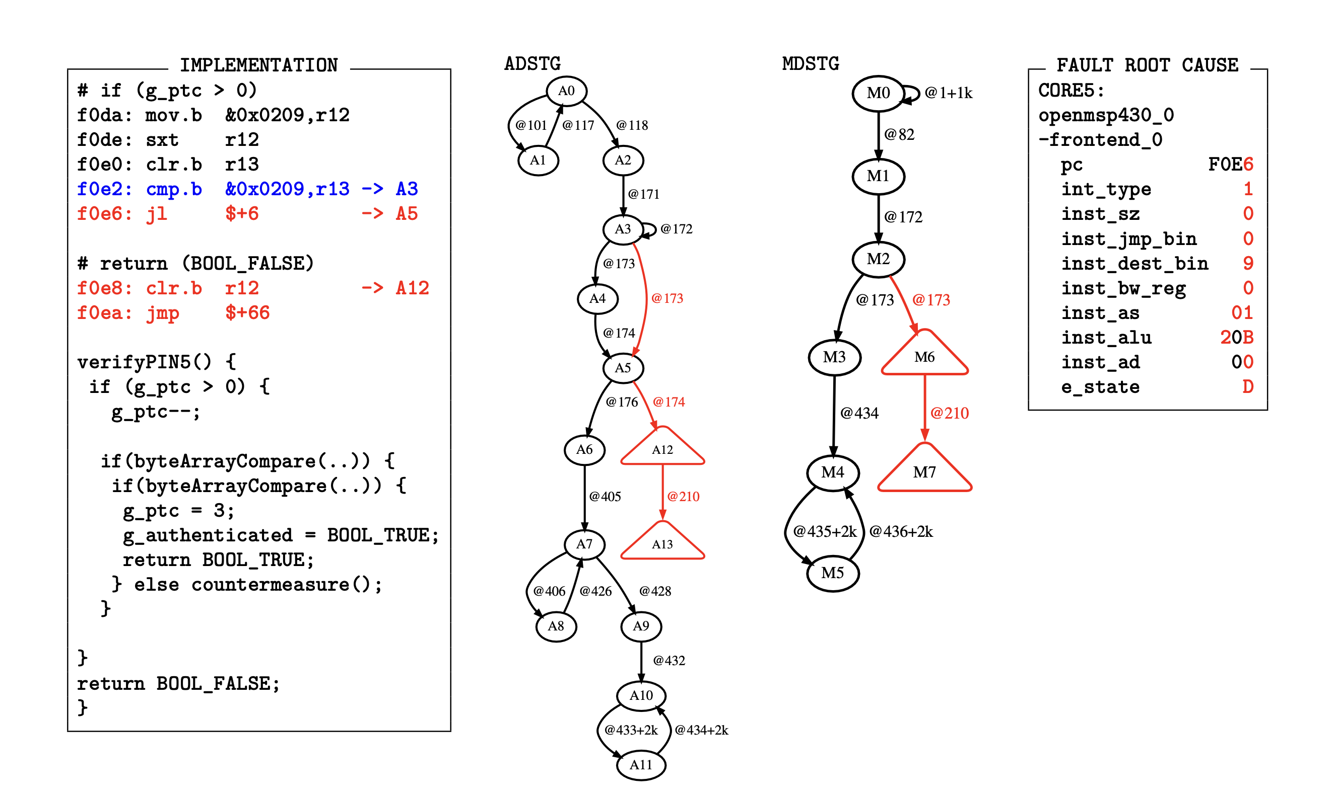
Fault Root-Cause Demonstration – Before Fault
VerifyPIN5
// Hardcoded user PIN
#define USER_PIN_0 0x01
#define USER_PIN_1 0x02
#define USER_PIN_2 0x03
#define USER_PIN_3 0x00
// Hardcoded card PIN
#define CARD_PIN_0 0x01
#define CARD_PIN_1 0x02
#define CARD_PIN_2 0x03
#define CARD_PIN_3 0x04
Architecture sane state
Micro-architecture sane state
Transition time
Use one single fault to bypass the pin verification process
Return True

Slide 15
Fault Root-Cause Demonstration – After Fault
Break the countermeasure
Clock glitching
@173
Skipped
Terminates the trial counter test
Skipped
Hardened Boolean is not implemented
Any positive value compromises the countermeasure
g_ptc
Cause the instruction sequencer to skip two instructions

Slide 16

Conclusion
FaultDetective can:
Achieve real-time fault detection at the earliest possible moment using hardware redundancy
Identify the earliest onset of a fault using a scan chain
Track fault propagation through a scan chain
Monitor system behavior using graphs (ADSTG/MDSTG)
Assist in the precise analysis of application failures
Bridge the gap between fault simulation based on fault models and fault testing based on real experiments
FaultDetective
This research was supported in part by
15

Slide 17
Any Questions?
Thank you
zliu12@wpi.edu

Slide 18
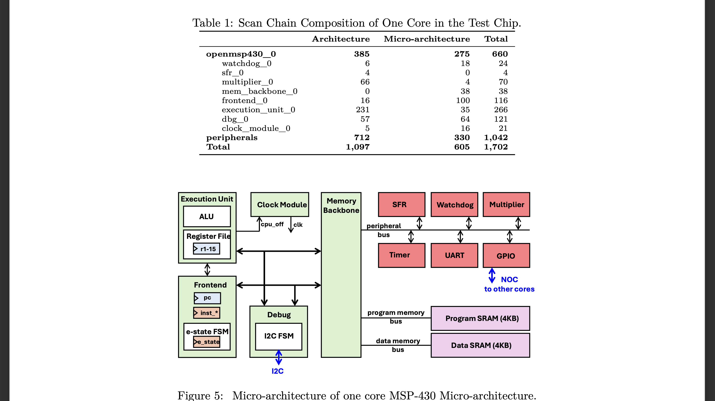
Realization in ASIC
Six MSP430 Cores
Total scan bits: 1702*6 = 10212
Micro-architecture of one core MSP-430 Micro-architecture
17

Slide 19
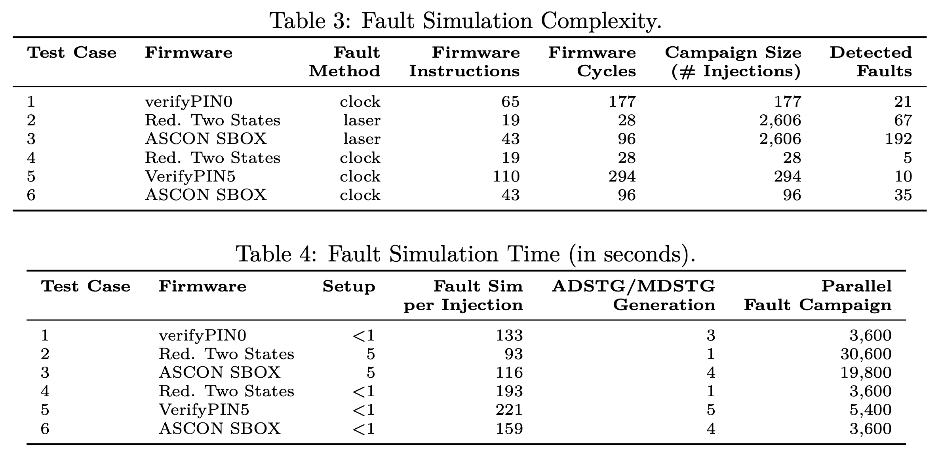
Simulation Results
18

Slide 20
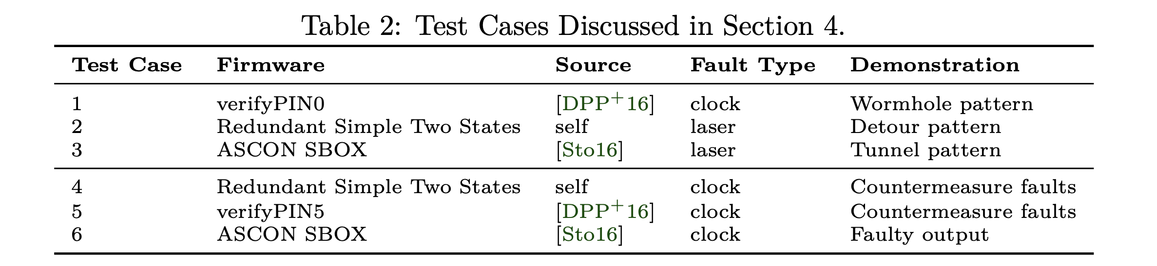
Fault Root-Cause Example
Target Firmware with fault pattern examples
19

Slide 21
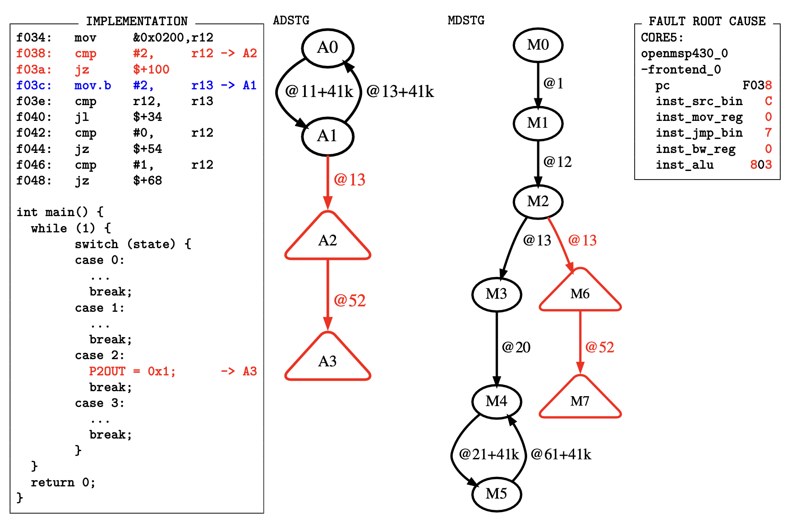
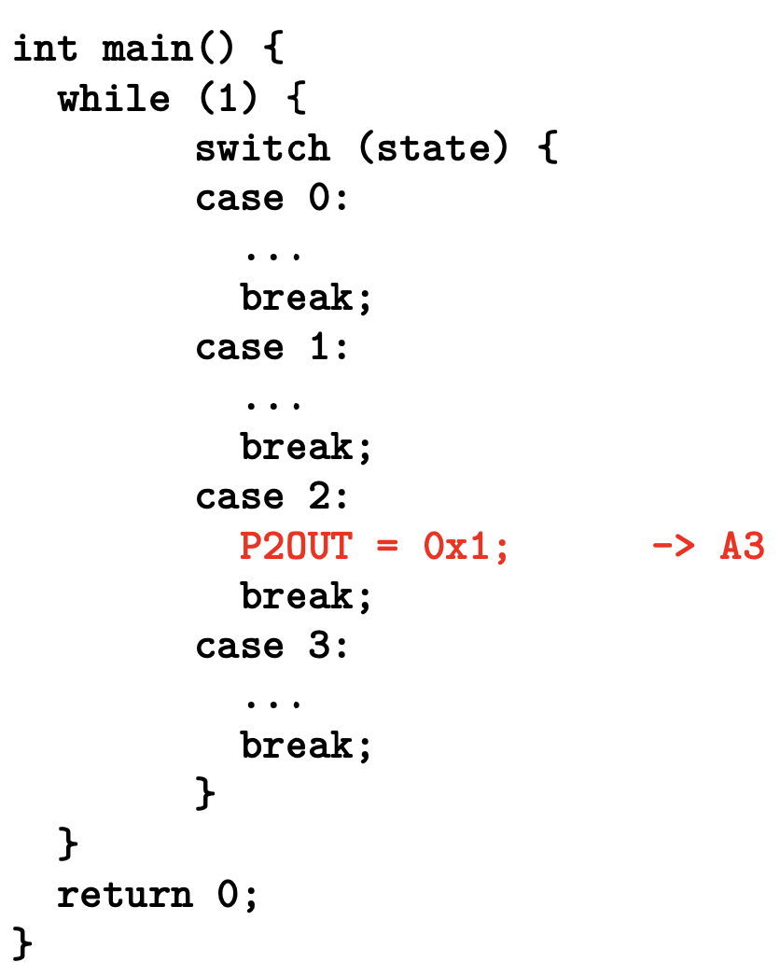
Fault Root-Cause Demonstration – Before Fault
A loop that only includes case0
A roundtrip of every 41 clock cycles
20

Slide 22
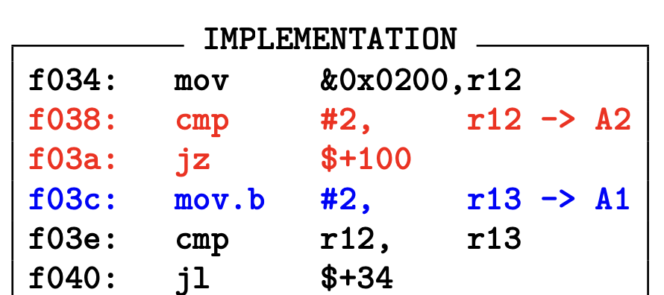
Fault Root-Cause Demonstration – After Fault
Clock glitching
@13
Faulted the case decoding instruction
switch(state)
PC register is faulted from F03E to F038 (jump backward)
F038: cmp r12 r12
Now jumped to F038
Suppose to execute F03E and proceed
21

Slide 23
Fault Root-Cause Demonstration – After Fault
F038: cmp r12 r12
A loop that only includes case0
Now entered case2!
22

Slide 24



Design-Layout Aware Simulation Framework
Simulation Tool
Framework
Post-Syn Netlist with Software Binary
Design-layout Aware Fault Simulation
Layout Data
Python
Post-Layout SDF
Fault Parameter Generation
Fault
Detected
Fault Parameter in Testbench
Multi-core Faulty Scan States
Signal
Activities
Fault Root-cause Analysis
Python
Scan State
Differential
&
Graph Generation
Weird Machine Analysis
Root-Cause
Choose
One
As the
Ground
Truth
Majority Voting
(posteriori)
ADSTG
Ground Truth
MDSTG
Golden Scan
(priori)
Non-faulted Scan States
C Code, Assembly, RTL Verilog
23

